Slide 1
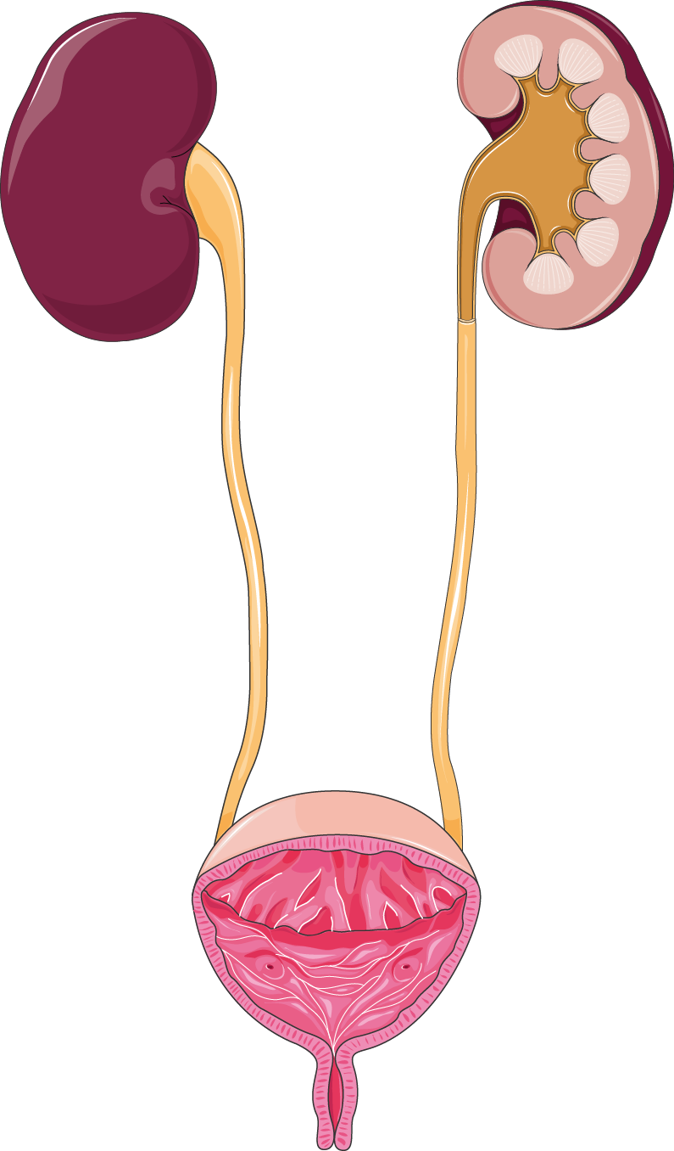
Chronic Kidney Disease Prediction Model
Samantha Zocher

Slide 2
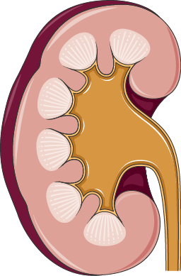
Why should we invest in CKD prediction models?
Researchers estimate that approximately 20 million people in the US have unidentified CKD or are at a high risk of developing CKD₁
Early stages of the disease typically have no noticeable symptoms
Detecting CKD in advanced stages usually leads to worse outcomes and irreversible effects

Slide 3
Past Attempts at CKD Prediction
Islam et al₂
Bahrami et al₃
Total cohort size: 400 participants
# of Features: 24
Best Model: XGBoost, F1 Score: 0.98
Top 3 features: hemoglobin, albumin, specific gravity
Total cohort size: 6,855
# of Features: 12
Best Model: Stratified k-fold neural network, F1 score: 0.94
Top 3 features: BMI, Hypertension, Glucose
Debal & Sitote₄
Bai et al₅
Total cohort size: 1,718
# of Features: 19
Best Model: Random Forest, F1 score: 0.78
Top 3 features: Creatinine, blood urine nitrogen (BUN), hemoglobin
Total cohort size: 748
# of Features: 34
Best Model: Naive Bayes, F1 score: 0.49
Top 3 features: Importance not reported

Slide 4

Data Source
Cohort
Patients with a chronic kidney disease diagnosis in their EHR based on ICD-10 code
Patients with a glomerular filtration rate of < 60
Recorded at least twice, 2 months apart or more₇
Excluded cancer patients
CKD Patients: 24,166
nonCKD Patients: 103,321
Funded by the NIH₆
Aims to enroll 1 million Americans
Collects demographic, EHR, and genetic data
Overall goal is to create a diverse & available dataset for researchers to improve health research and care

Slide 5
Engineered Features
Demographic
Ethnicity
Race
Sex
Age
Lab
BMI
Diastolic blood pressure
Systolic blood pressure
Albumin
Creatinine
Glucose
Potassium
Sodium
Blood Urea Nitrogen
RBC
Hemoglobin
WBC
Alkaline Phosphatase
Calcium
Chloride
Proteinuria
Comorbidities
Anemia
Diabetes
Hypertension
Coronary Artery Disease
Lifestyle
Smoking status
Alcohol score
Social Determinants of Health
Afford PCP
Self-Reported
Physical health score
Mental health score
Genetic
Polygenic risk score

Slide 6
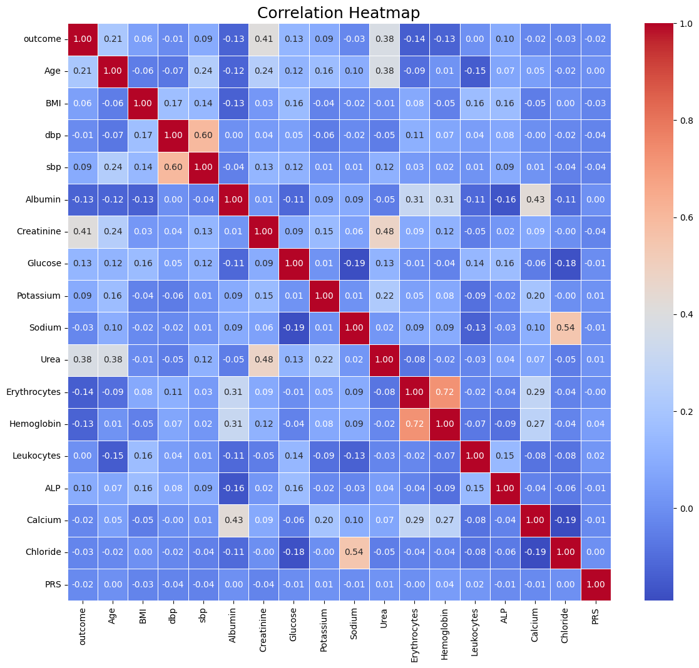
Correlation Matrix
Checking for multicollinearity

Slide 7
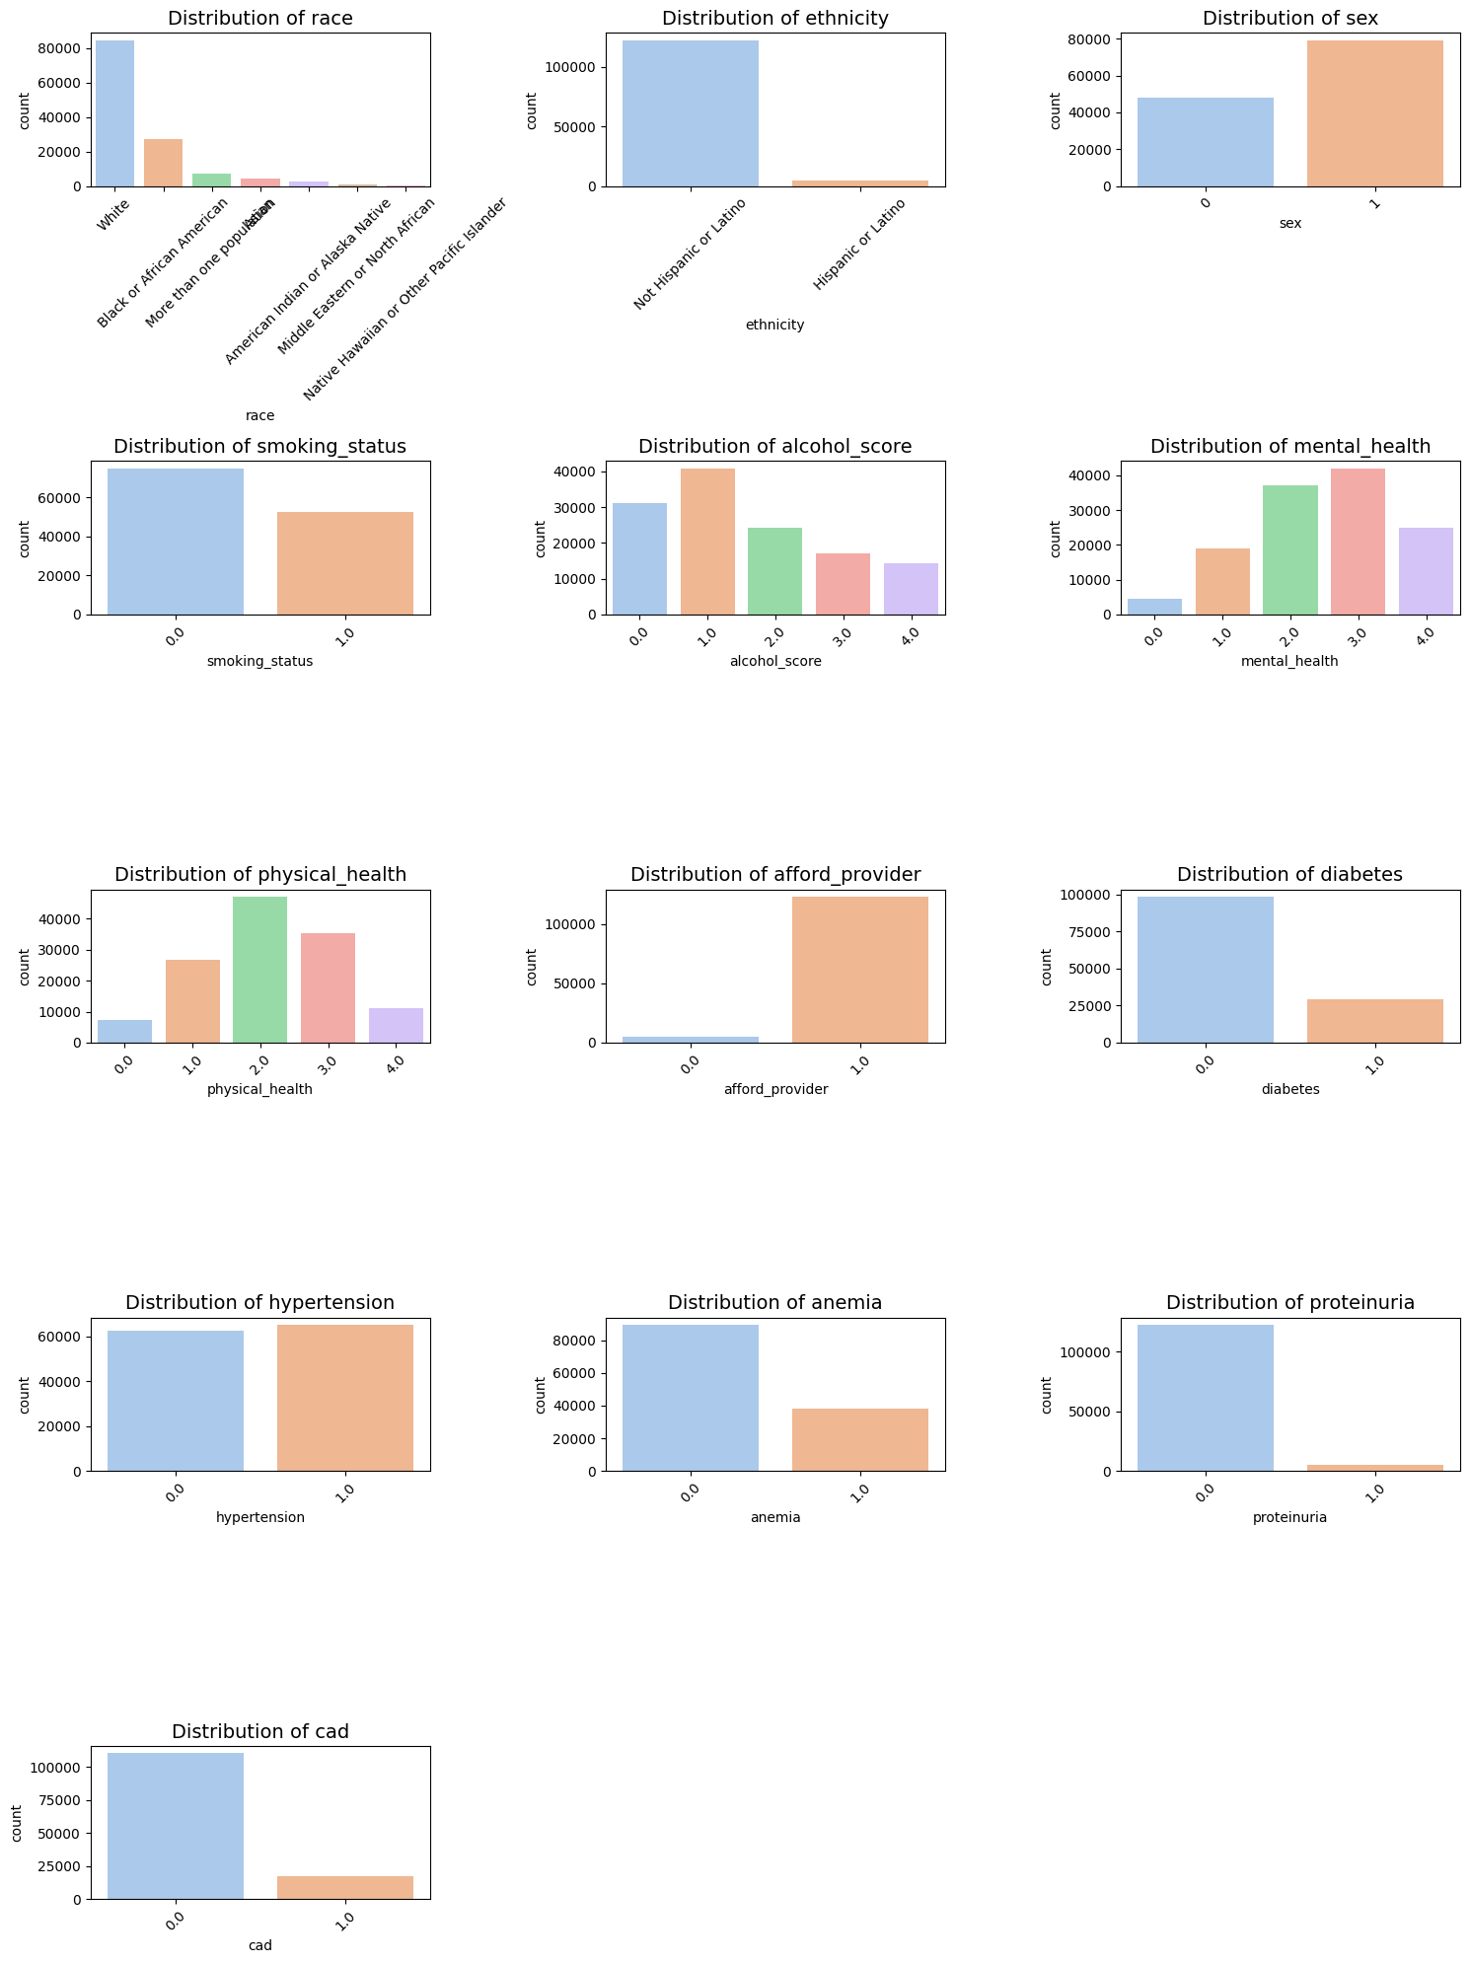
Categorical Features
Some features have distinct class imbalances
Import to note some features may not predict well because of this

Slide 8
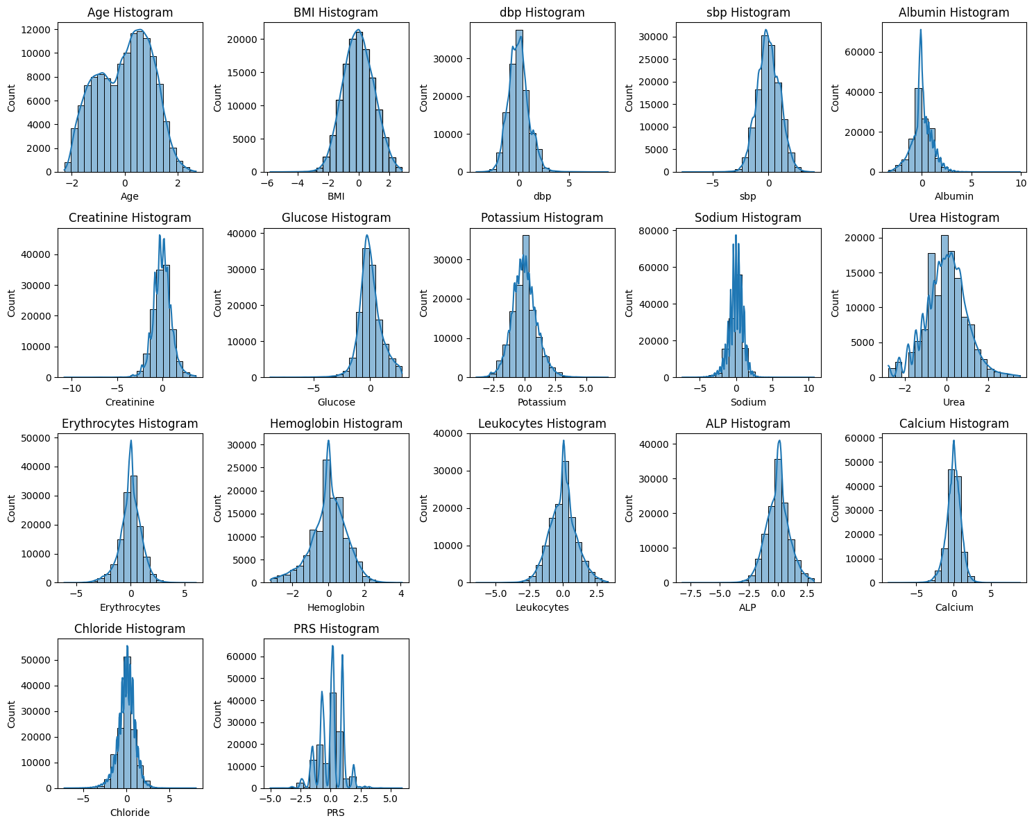
Distribution of continuous variables after transformations
Normalization for nonnormal variables
Standard scalar for all variables

Slide 9
Model Results without Hyperparameter Tuning
Model Type | Decision Tree | Random Forest | XGBoost | AdaBoost | Neural Network
Accuracy | 0.85 | 0.88 | 0.84 | 0.86 | 0.83
Precision | 0.59 | 0.78 | 0.55 | 0.65 | 0.53
Recall | 0.63 | 0.49 | 0.79 | 0.60 | 0.79
F-1 Score | 0.61 | 0.60 | 0.65 | 0.62 | 0.63

Slide 10
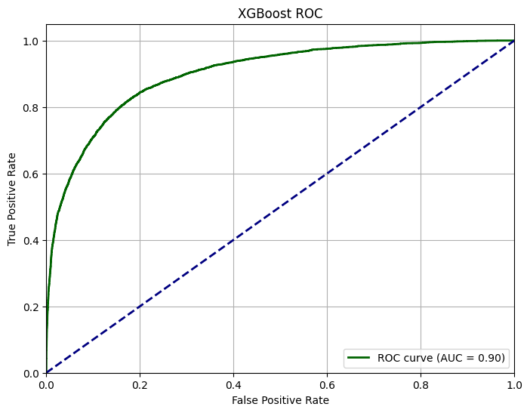
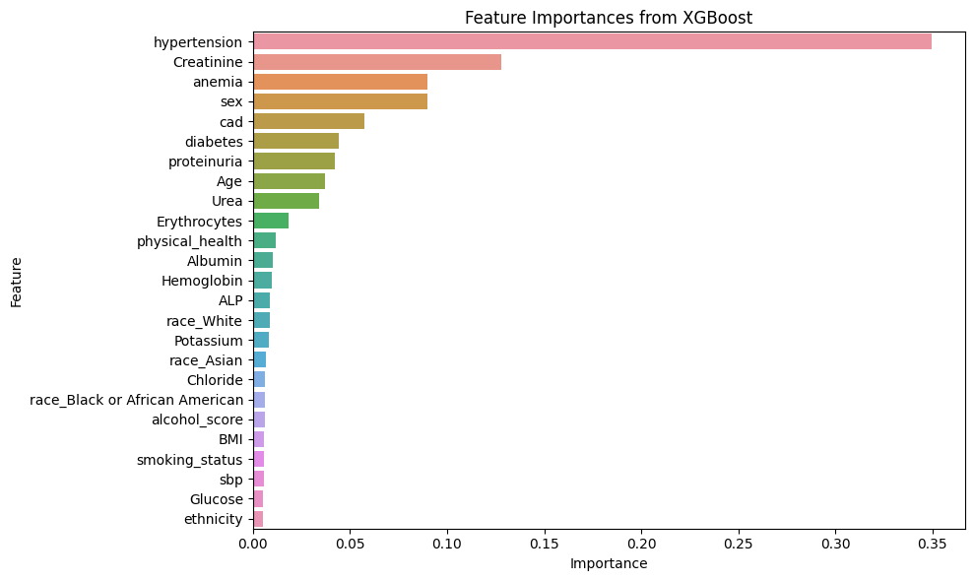
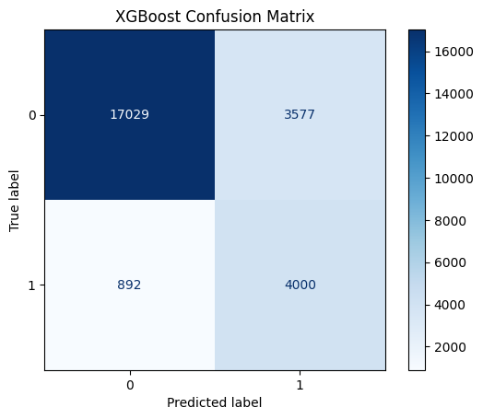
Best Performance: XGBoost Tuned Model
Goal: Optimize Recall
Accuracy: 0.82
Precision: 0.53 Recall: 0.82
F1 score: 0.64

Slide 11
Limitations
Imbalanced dataset
Incomplete data
Lack of a diverse cohort
Future Direction
As All of Us continues to recruit participants, this research should be repeated and tuned accordingly
Try a smaller cohort with complete features
Conclusion
CKD models with small samples from one source perform well, but more generalizable models need to be built in order for clinical implementation to be possible
Models could catch CKD in the early stages and improve prognosis

Slide 12
References
Whaley-Connell A, Nistala R, Chaudhary K. The importance of early identification of chronic kidney disease. Mo Med. 2011 Jan-Feb;108(1):25-8. PMID: 21462606; PMCID: PMC6188457.
Islam MA, Majumder MZH, Hussein MA. Chronic kidney disease prediction based on machine learning algorithms. J Pathol Inform. 2023 Jan 12;14:100189. doi: 10.1016/j.jpi.2023.100189. PMID: 36714452; PMCID: PMC9874070.
Bahrami, P., Tanbakuchi, D., Afzalaghaee, M. et al. Development of risk models for early detection and prediction of chronic kidney disease in clinical settings. Sci Rep 14, 32136 (2024). https://doi.org/10.1038/s41598-024-83973-5
Debal, D.A., Sitote, T.M. Chronic kidney disease prediction using machine learning techniques. J Big Data 9, 109 (2022). https://doi.org/10.1186/s40537-022-00657-5
Bai, Q., Su, C., Tang, W. et al. Machine learning to predict end stage kidney disease in chronic kidney disease. Sci Rep 12, 8377 (2022). https://doi.org/10.1038/s41598-022-12316-z
All of Us Research Program Investigators; Denny JC, Rutter JL, Goldstein DB, Philippakis A, Smoller JW, Jenkins G, Dishman E. The "All of Us" Research Program. N Engl J Med. 2019 Aug 15;381(7):668-676. doi: 10.1056/NEJMsr1809937. PMID: 31412182; PMCID: PMC8291101.
Kidney failure risk factor: Estimated glomerular filtration rate (egfr). National Kidney Foundation. August 13, 2024. Accessed April 23, 2025. https://www.kidney.org/kidney-failure-risk-factor-estimated-glomerular-filtration-rate-egfr.

Slide 13
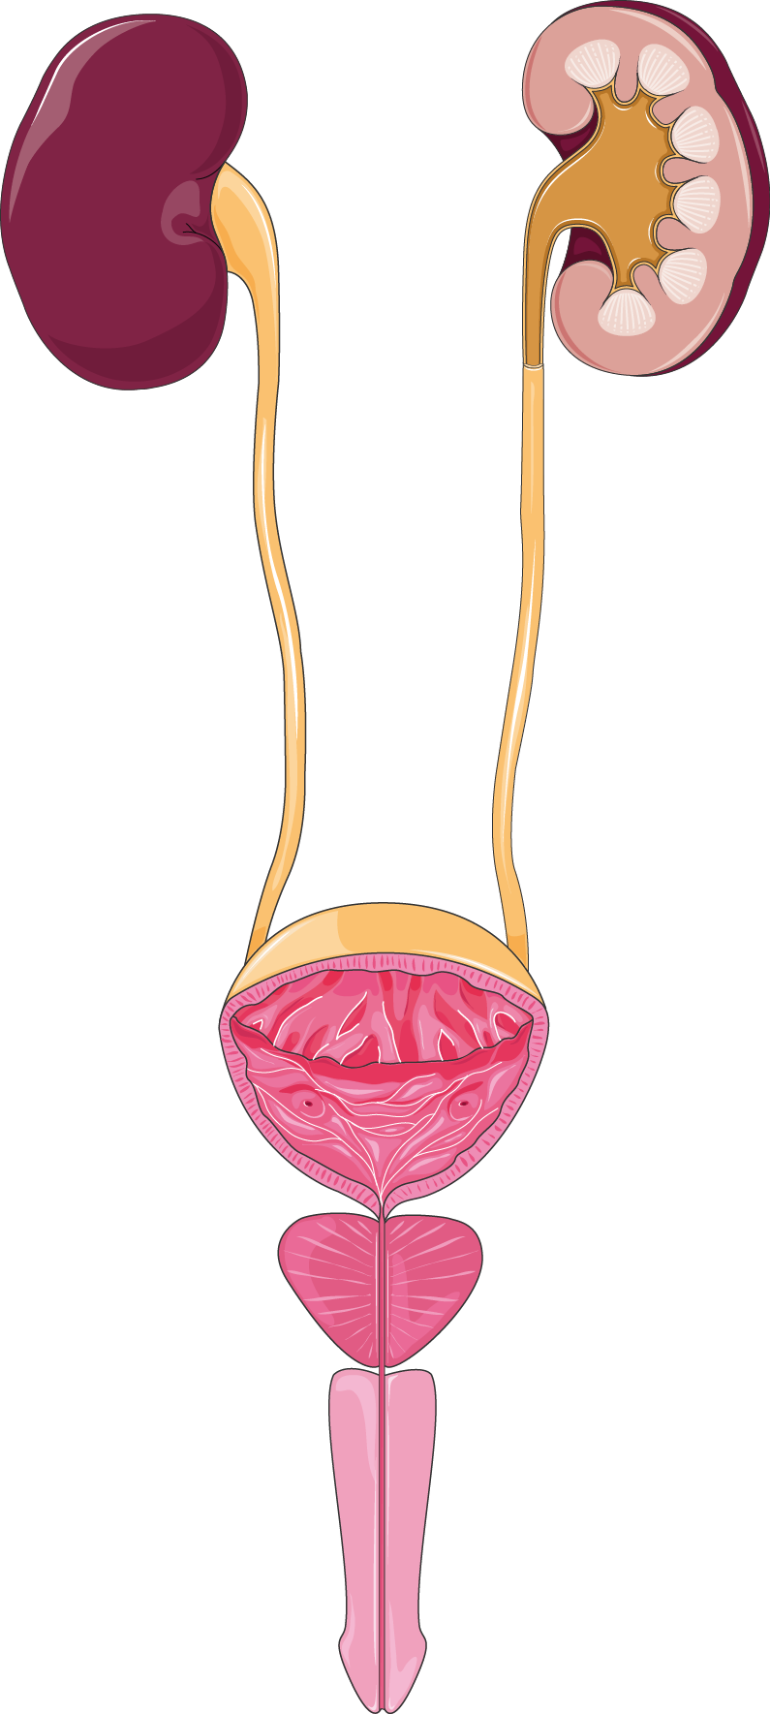
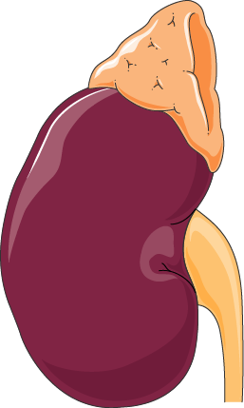
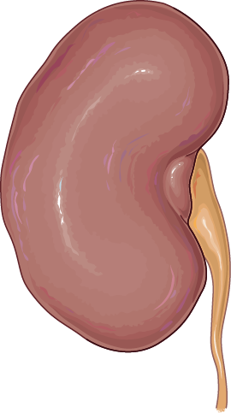
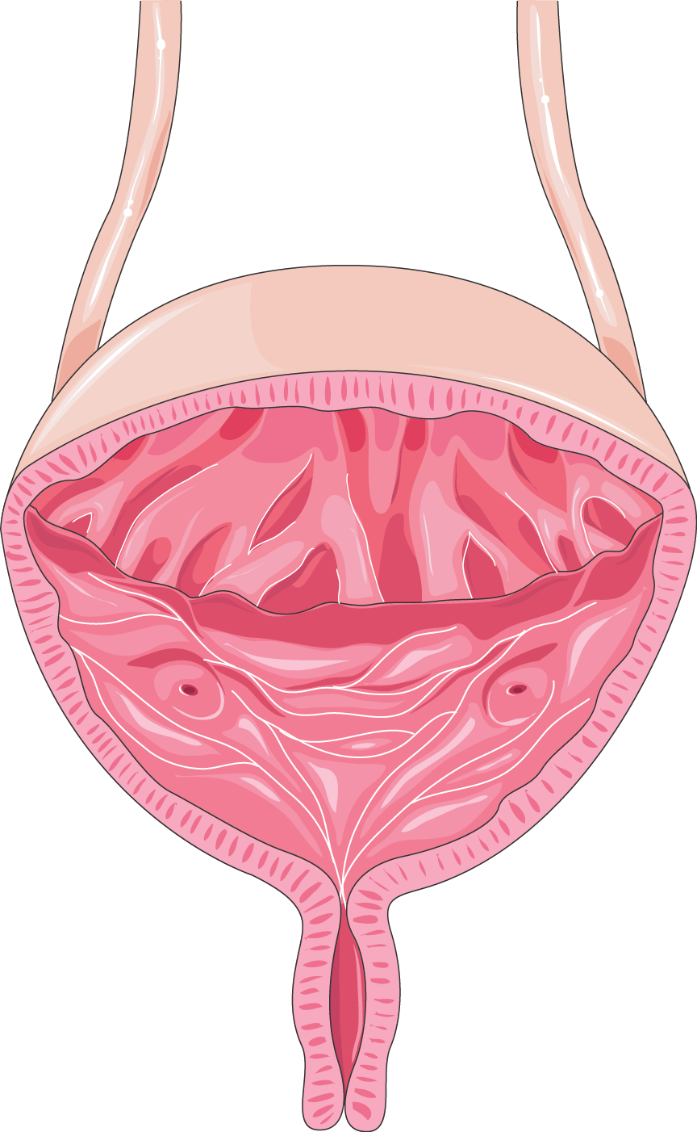

Thank you! Questions?

